Slide 1
Design Patterns for Concurrency
Germain Le Chapelain, LaSalle College, 2023

Slide 2
Active Object
Using a BlockingQueue..
…Synchronizing calls to method, that may be concurrent
Seems Java specifics?

Slide 3
Balking pattern
Bail when an object is not in a correct state to execute a method
Anti pattern
Dual of `Guarded Suspension’ Design Pattern (Used when object can be in a state where it is impossible to execute a method for too long.)

Slide 4
Barrier
Block a group of thread of known sized until all have reached the known sized:
C++ std::barrier
Python threading.Barrier

Slide 5
Double-checked locking
When you check whether the object is locked before locking it yourself
std::mutex::try_lock
WaitForSingleObject(0)
test-and-set CPU instruction

Slide 6
Guarded suspension
Hold execution of a method until the object is in an acceptable state to execute it
Dual of the Balking Pattern (For when the object will be in a state unacceptable to execute a method for a known and acceptable time.

Slide 7
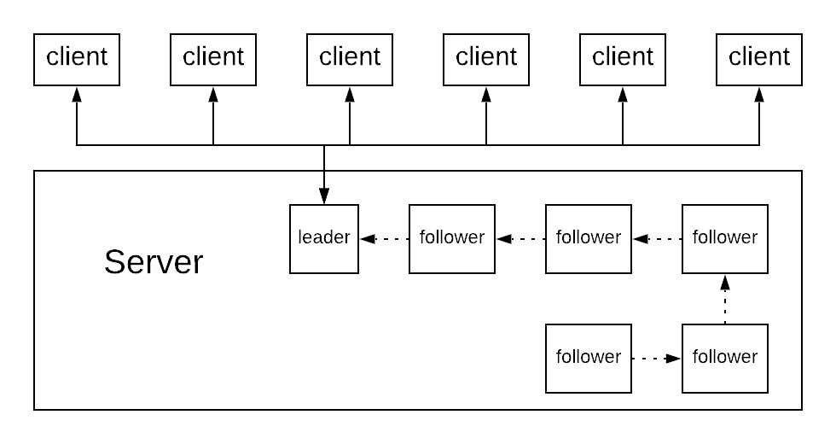
Leader/Followers
https://stackoverflow.com/questions/3058272/explain-leader-follower-pattern
When not enough threads can be created due to platform limitation

Slide 8
Monitor Object
Extension of simple-lock:
Protect all access through methods behind a lock
Simple but error-prone

Slide 9
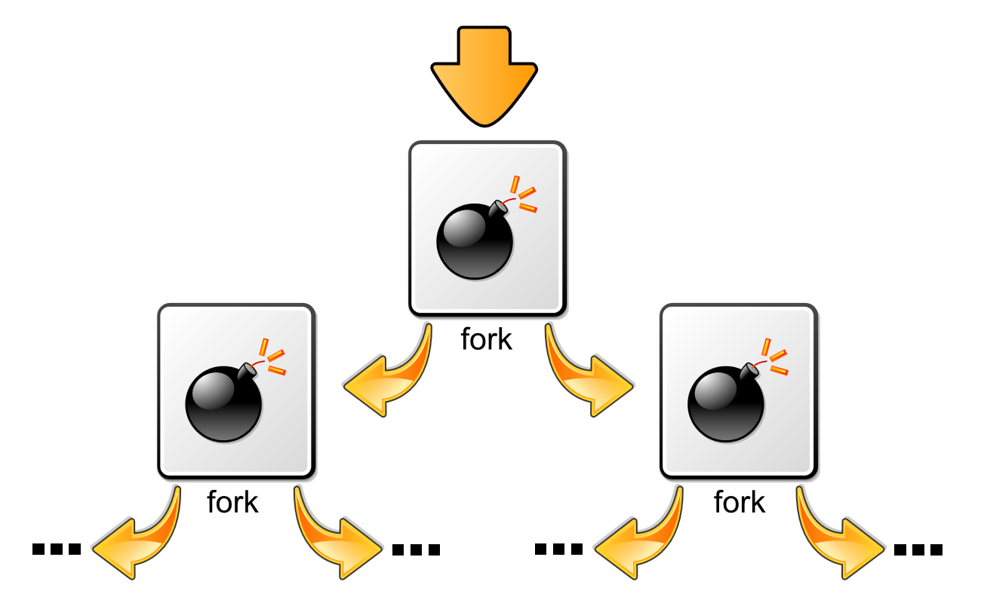
Nuclear reaction
Fusion/Fission
Only found on Wikipedia (with comments)
Used for ALSA implementation (sound on Linux.)
https://en.wikipedia.org/wiki/Fork_bomb

Slide 10
Reactor pattern
`Absorb’ Events concurrently
Dispatch them synchroneously
Used in Node.js

Slide 11
Read write lock pattern
std::shared_mutex <- primitive, but recent
Win32 has to implement ! (thus the pattern)
Unix file locks

Slide 12
Scheduler pattern
? <- https://www.youtube.com/watch?v=sGflGs2s1Bg
For actual kernel (scheduling processes & thread)
A science (operation research, queue management)
To affect operating system scheduler in your program:
Set affinity
Set priority

Slide 13
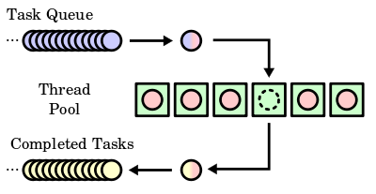
Thread pool pattern
https://en.wikipedia.org/wiki/Thread_pool
Also called
replicated workers
worker-crew model

Slide 14
Thread-local storage
#include <threads.h> thread_local int foo = 0;

Slide 15
But wait… …there is more!
https://en.wikipedia.org/wiki/Concurrency_pattern
http://www.se-radio.net/2006/04/episode-12-concurrency-pt-1/
http://www.se-radio.net/2006/06/episode-19-concurrency-pt-2/
http://www.se-radio.net/2006/09/episode-29-concurrency-pt-3/
Bonus Design Pattern from the radio🎵🎶
Simple-lock (I guess if you only have one atomic operation.)
Futures! (Haven’t looked std::async further.)
Scope-locking (not in Java?)

Slide 16
But What’s Really Used in production ?

Slide 17
Can you guess?

Slide 18
Still not?

Slide 19
Let’s have a look!
That thing I was telling you by email

Slide 20
Looked for `listen’ in the “core” source code
Searching for `listen()’ in https://svn.apache.org/repos/asf/httpd/httpd/trunk/server

Slide 21
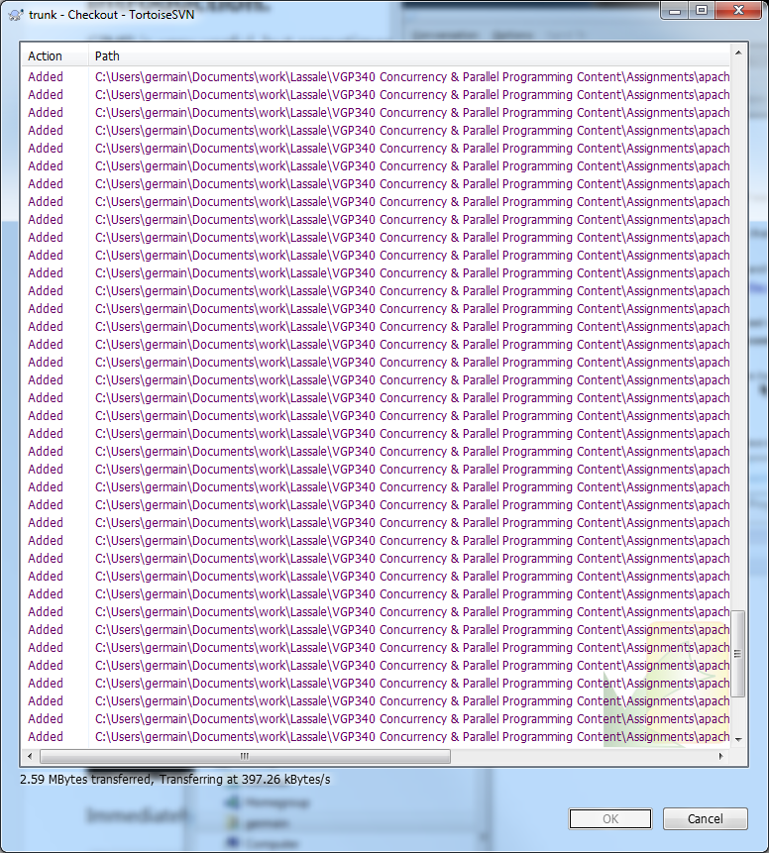
https://svn.apache.org/repos/asf/httpd/httpd/trunk/server
Subversion repository
Branch
“Core” Source Code

Slide 22
But why listen() actually ? (I spoke of it last lesson about open())

Slide 23
But why listen() actually ? (I spoke of it last lesson about open())

Slide 24
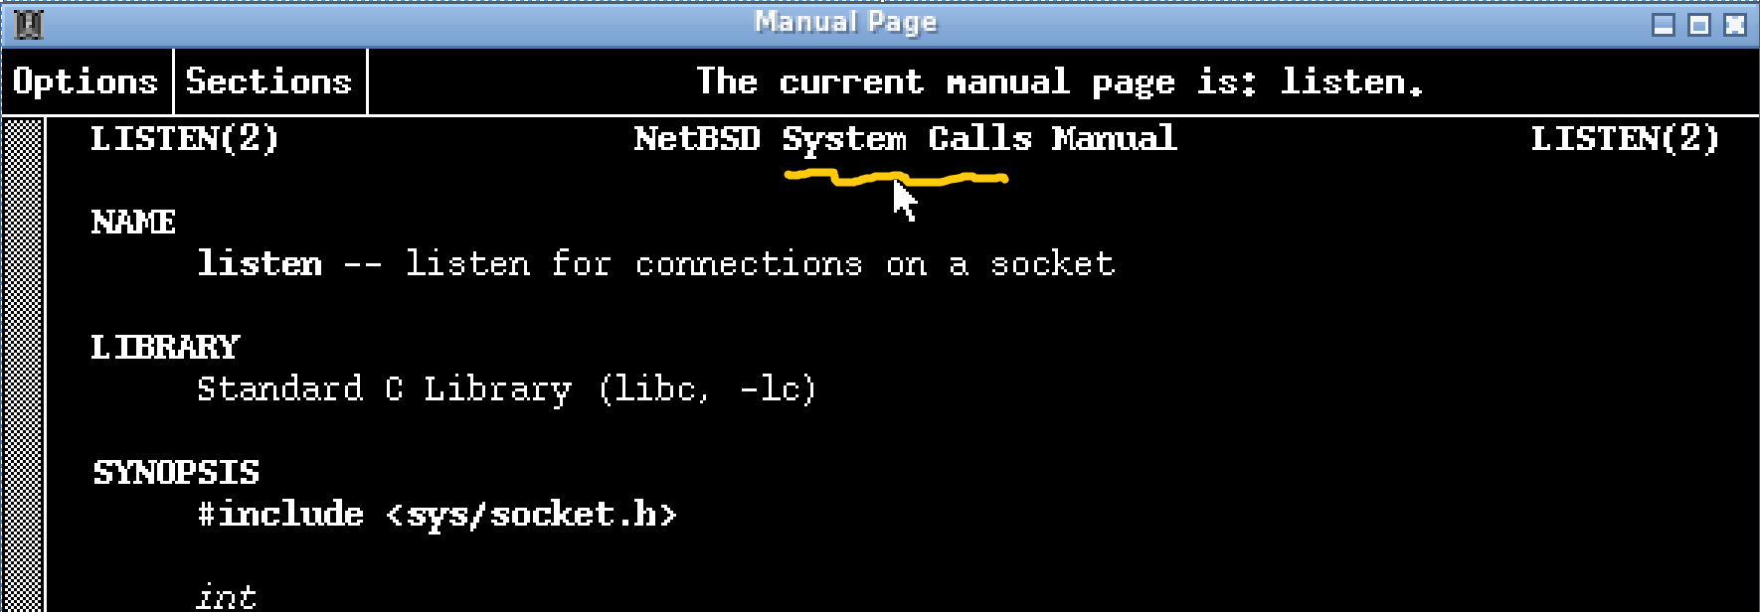
But why listen() actually ? (I spoke of it last lesson about open())

Slide 25
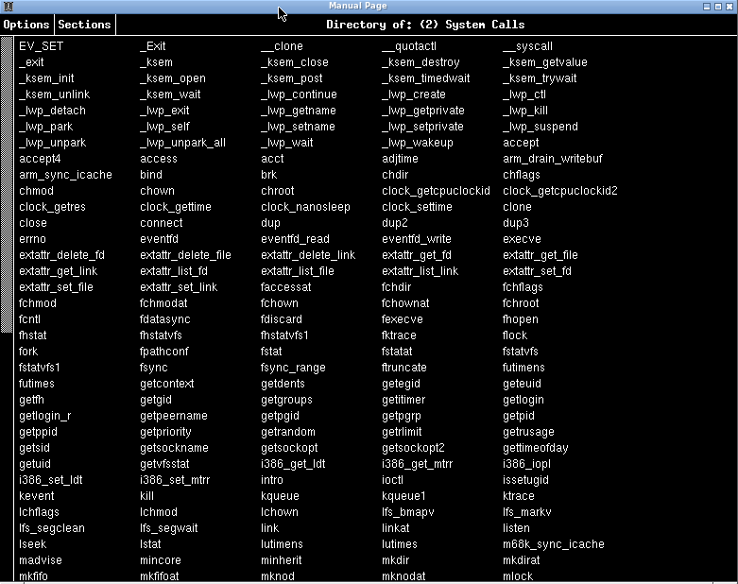
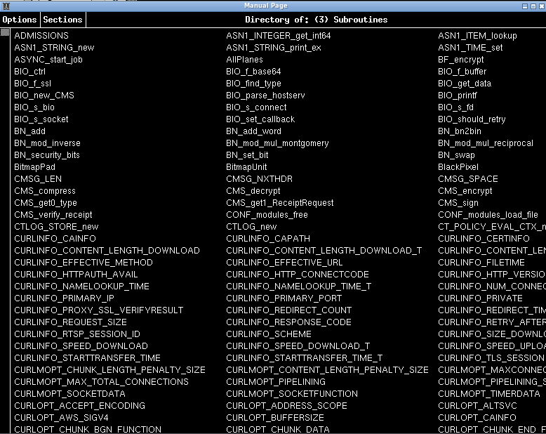
List of System calls
List of other subroutines
See the scrollbars for scale

Slide 26
I never found listen() per-se
Found a apr_socket_listen() instead
But it is the one:
(Googled it
Found apr
Looked for a apr package for my OS and looked at its sources.)
So following the calls to that function instead…
…back to main()

Slide 27
…it turns out Apache has many threading implementations and several models
In server/mpm/MPM.NAMING
Simple
Prefork
Winnt
worker
Event
https://stackoverflow.com/questions/16354460/forking-vs-threading
(^due to fork being prevalent on UNIX vs threads on MS Windows…)
https://serverfault.com/questions/383526/how-do-i-select-which-apache-mpm-to-use

Slide 28
Mine is Prefork
… #LoadModule mpm_event_module lib/httpd/mod_mpm_event.so LoadModule mpm_prefork_module lib/httpd/mod_mpm_prefork.so #LoadModule mpm_worker_module lib/httpd/mod_mpm_worker.so …
httpd.conf for http://lanvaux.ca

Slide 29
Scheduling (nothing to do with the topic.)

